Slide 1


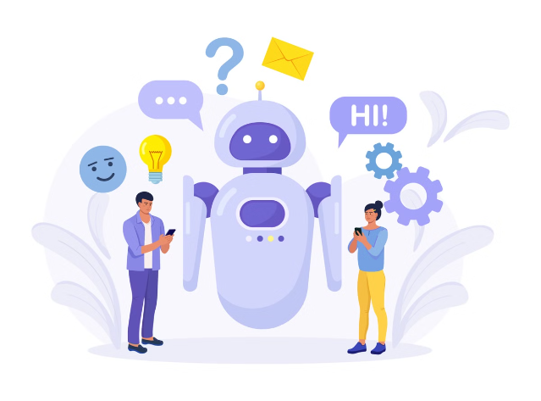
VTS LLM Chatbot
An interactive AI-powered chatbot application with personalized assistance, multilingual support, and image integration.

Slide 2

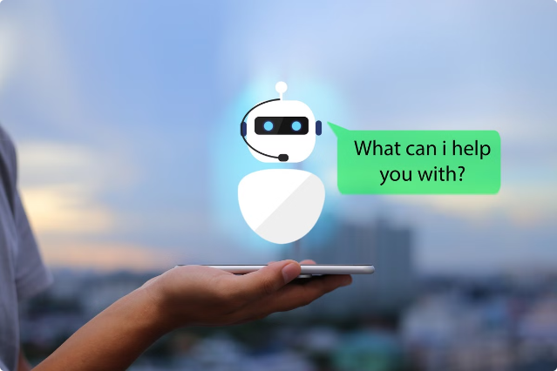
Introduction
The VTS LLM Chatbot utilizes advanced technologies to engage users in informative conversations, offering versatile features for a seamless user experience.

Slide 3
Key Features
1
Personalized Assistance
2
Multilingual Support
3
Image Integration
Offers responses in multiple languages.
Analyzes and responds to image inputs.
Provides detailed, contextually relevant responses.
4
Customizable Responses
5
Safety and Moderation
Allows users to adjust response parameters.
Ensures respectful and safe interactions.

Slide 4

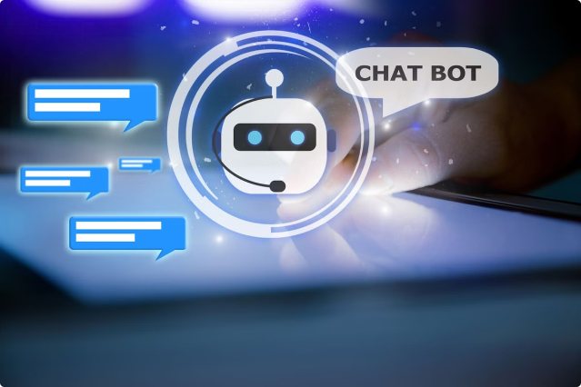
Personalized Assistance
The chatbot uses Google Generative AI to understand queries and generate accurate, detailed responses, providing users with a knowledgeable assistant around the clock.

Slide 5

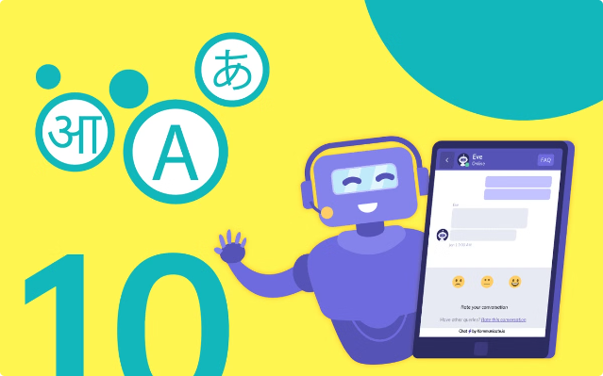
Multilingual Support
The chatbot supports responses in various Indian and foreign languages, making interactions more inclusive and comfortable for users across different linguistic backgrounds.

Slide 6

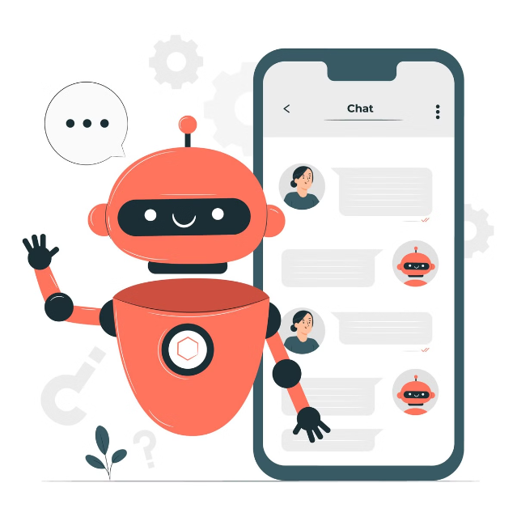
Image Integration
Users can upload images for the chatbot to analyze and provide insights or generate responses based on the visual content, enhancing the user experience.

Slide 7

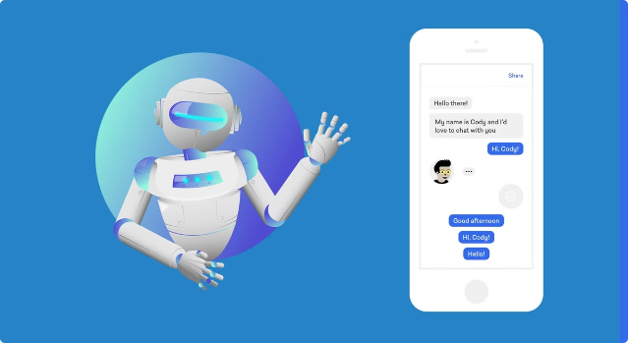
Customizable Responses
The chatbot allows users to adjust parameters like temperature and output tokens, ensuring that responses align with their preferences for concise or elaborate explanations.

Slide 8

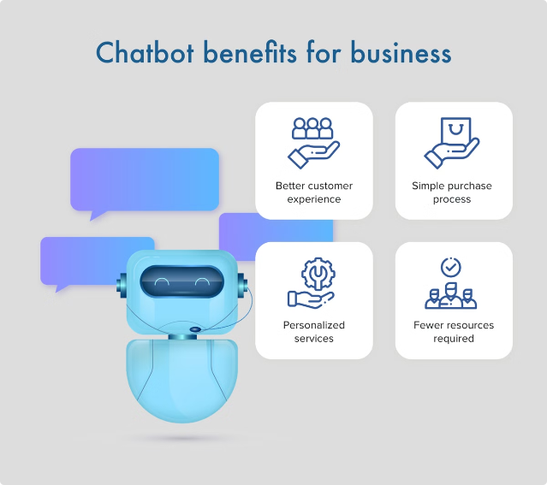
Safety and Moderation
The chatbot includes configurable safety settings to filter out inappropriate or harmful content, ensuring a positive and respectful interaction environment for users.

Slide 9
Technical Specifications
Backend
Text-to-Speech
Language Transliteration
Google Generative AI API
Google Text-to-Speech (gTTS)
Google Translator Library
Frontend
Image Processing
Cloud Hosting
Streamlit
PIL (Python Imaging Library)
Hugging Face

Slide 10

Challenges and Solutions
Content Moderation
Multilingual Support
Implemented configurable safety settings to filter out harmful content and manage interactions effectively.
Integrated language selection and transliteration features to accommodate various languages and scripts.
User Experience
Developed features for downloading, copying, and listening to responses, enhancing user accessibility and interaction.

Slide 11
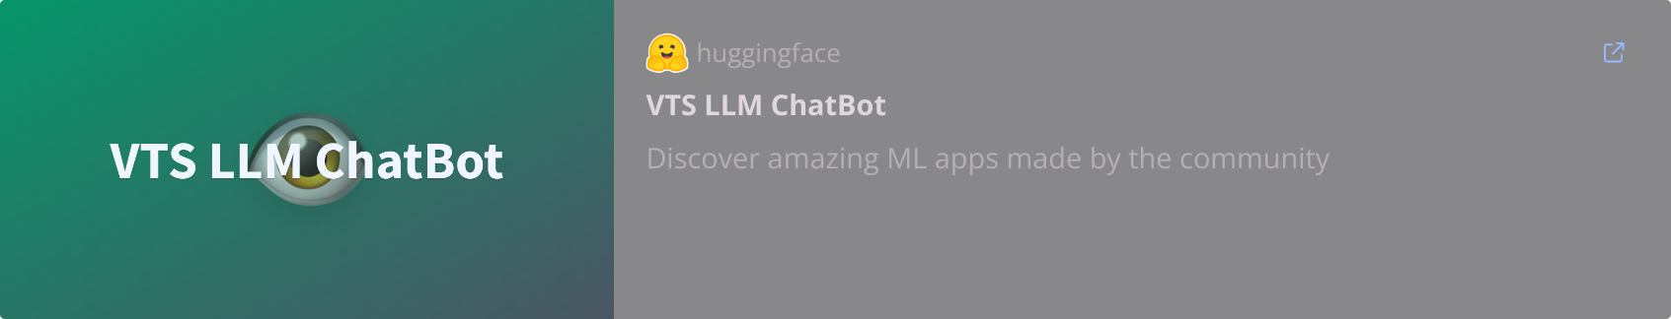
Cloud Hosting

Slide 12
Pricing
- VTS LLM Chatbot: Pricing varies based on implementation, including API calls, storage, and processing. Custom pricing may be available depending on specific requirements.
- Other Chatbots:
ChatGPT: Offers a free tier with limited usage. Subscription plans are available, providing enhanced features and higher usage limits. Pricing depends on subscription level and usage.
Gemini: Offers free and paid plans with varying levels of access and usage. Pricing details depend on specific services and usage levels.
Other Market Chatbots: Pricing models vary widely, including free tiers, subscription-based plans, or pay-per-use pricing. Costs depend on features, usage volume, and additional services.

Slide 13
Conclusion
The VTS LLM Chatbot represents a significant advancement in AI-driven interactive applications. It combines powerful AI capabilities with a user-friendly interface, offering a comprehensive suite of features for engaging and interactive chatbot experiences. The project addresses key aspects of user interaction, content management, and accessibility, setting a foundation for future enhancements and scalability.

Slide 14
Thank You

